Slide 1
Heart Disease Prediction using Machine Learning (Feature Engineering On Healthcare Patient Records)
Machine Learning Mini Project Name – Prachi Gaur B.tech(cse) / Lloyd institute of technology(aktu)

Slide 2
Introduction
Heart Disease Prediction using Machine Learning
Machine Learning can help doctors predict the possibility of heart disease based on patient health data.
Feature Engineering improves model performance
In this project, we use a Machine Learning model to predict whether a person has heart disease or not.

Slide 3
Problem Statement
The problem is to predict whether a person has heart disease or not using medical data such as age, cholesterol, blood pressure, and other health parameters by applying machine learning techniques.

Slide 4
Dataset Description
Dataset contains the following features:
Age
Sex
Chest Pain Type
Blood Pressure
Cholesterol
Blood Sugar
ECG Results
Heart Rate
Exercise Angina
ST Slope

Slide 5
TOOLS &TECHNOLOGY
Python
Jupyter Notebook
Pandas
NumPy
Matplotlib
Seaborn
Scikit-learn

Slide 6
Data Processing
Before training the model , data needs to be prepared.
Step Performed:
Check for missing values
Load dataset using Pandas
Convert categorical data into numeric values using One Hot Encoding
Separate features and target variable

Slide 7
Feature Engineering
New Features Created:
Age Group (Young, Middle, Old)
High Risk Indicator (Based on BP & Cholesterol)
Encoded Gender (Male = 1, Female = 0)
Encoded Smoking (Yes = 1, No = 0)
Feature engineering helps improve model learning.

Slide 8
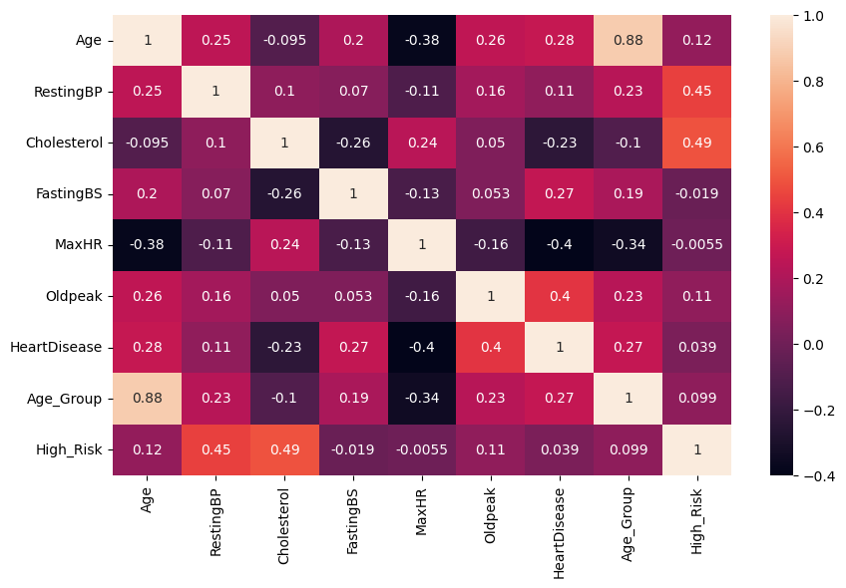
Correlation Analysis
A heatmap was used to visualize relationships between different features in the dataset.
It helps identify which variables are positively or negatively related to heart disease.
Features like Age, Cholesterol, Resting Blood Pressure, and Oldpeak show noticeable correlation with heart disease.
Max Heart Rate (MaxHR) shows a negative correlation with heart disease.
Correlation analysis helps in understanding important factors and selecting useful features for the model.

Slide 9
Model Building
We Used Logistic Regression Algorithm:
Split dataset into training data and testing data
Train the model using training data
Predict results using test data

Slide 10
RESULTS
We built a heart disease prediction model
Feature engineering improved performance
Achieved good accuracy on test data
Used Logistic Regression algorithm

Slide 11
THANK YOU

